Slide 1
Map of the crime rate in San Francisco
ZE WEI

Slide 2
Introduction
For people in wish to move San Francisco, whether for its beaches or other things, they want to live in a safe location. This project aims to analysis data of this city to find safe areas. We will explore crime rate in San Francisco, California to solve this problem. Finally we will draw a Cleopleth map of crimes in San Fransico.

Slide 3
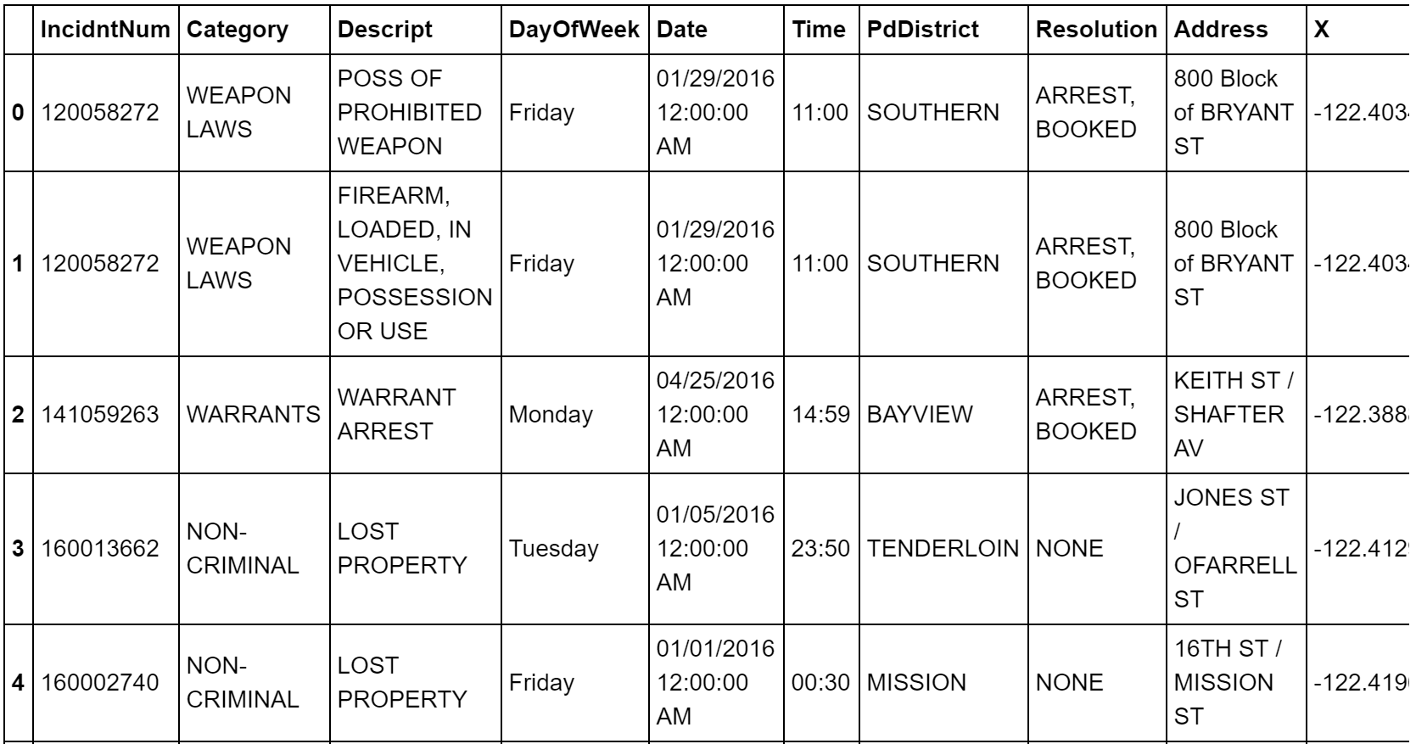
Data

Slide 4
Methodology
We analysis data to view the total number of crimes in each neighborhood (Central, Northern, Park, Southern, Mission, Tenderloin, Richmond, Taraval, Ingleside, Bayview). After that, we use map of San Francisco to visualize this data. With the number, we can view areas where have a high-rate crime. And with map we can see easily about the area where safe.

Slide 5
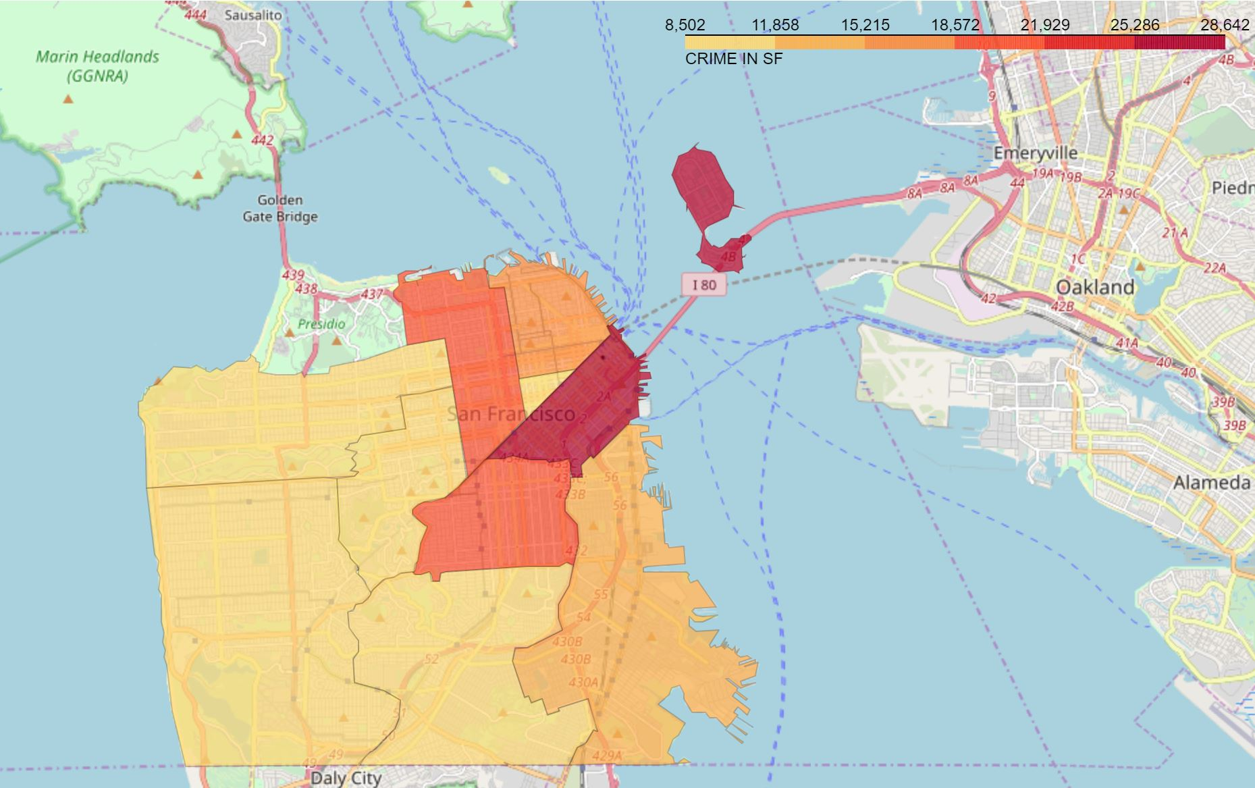
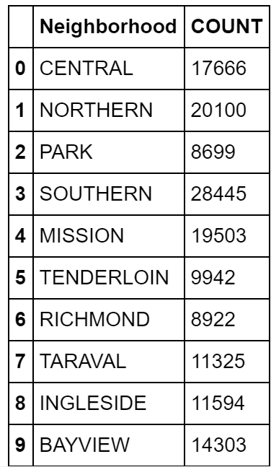
Results.

Slide 6
Conclusion
The highest rate is in Southern and the lowest rate is in Park. After reviewing rate of crime map, we recommend that people can choose some neighborhood to living such as park, tenderloin, Richmond.

